Slide 1
Heterogeneous Supernova Production of Ti and Cr Isotopes
Jack Schulte^{1,2,∞}
Maitrayee Bose^{1,∞}, Patrick Young¹, and Gregory Vance¹
¹School of Earth and Space Exploration, ²Department of Physics
∞ Center for Isotope Analysis (CIA)

Slide 2
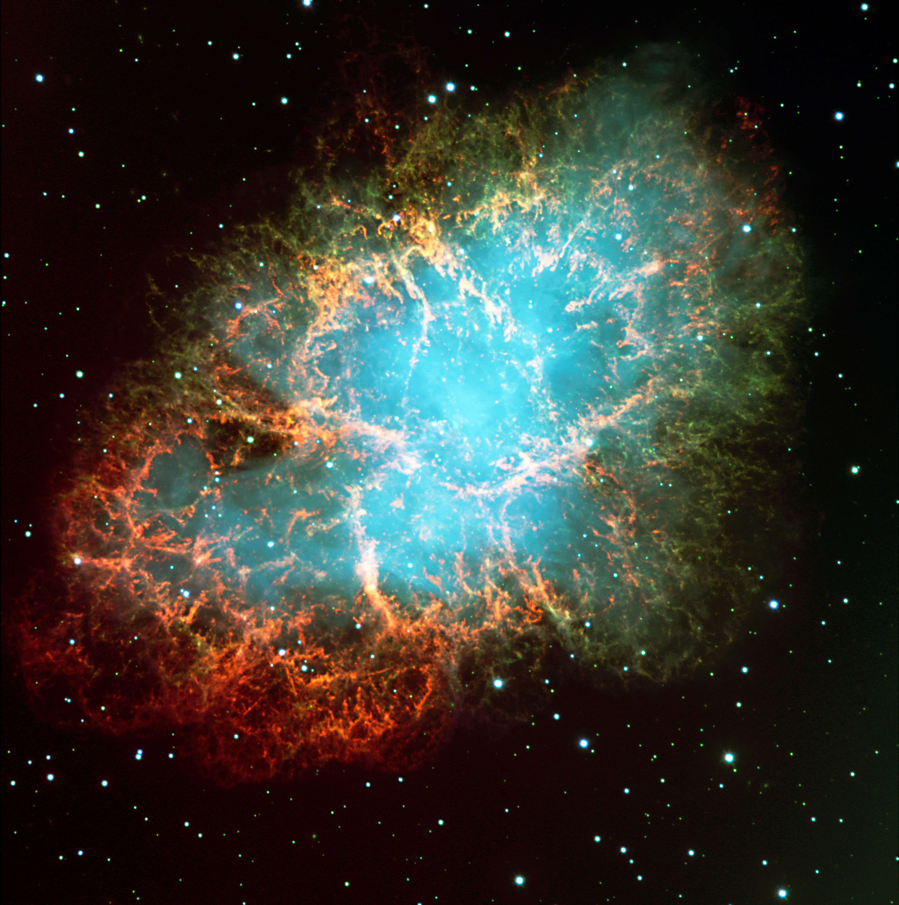
Exploding stars
Intro
Methods
Results
Conclusions
Stars > 8 M⊙ die as core-collapse supernovae (CCSN)
Electron-capture supernovae (ECSN) usually have 8-10 M⊙
White dwarf in binary system can trigger a Type Ia supernova
Slow deflagration, fast deflagration, detonation
Supernova ejecta is heterogeneous and seeded our solar system
Crab Nebula
Credit: European Southern Observatory
Notes:
Type Ia supernova occurs when white dwarf accretes enough matter from companion or combines with companion to exceed Chandrasekhar limit (1.44 Msol)
CCSN

Slide 3
Methodology
Intro
Methods
Results
Conclusions
Two three-dimensional CCSN models created by SESE’s Prof. Patrick Young
Four one-dimensional Type Ia and ECSN models taken from Nittler et al. (2018)
3D CCSN models analyzed using MATLAB and matplotlib in Python
The 3D CCSN models have been scrutinized over three years with continuous financial assistance from ASU/NASA Space Grant (Schulte et al. 2021)
 | 15S (CCSN) | 15A (CCSN) | Type Ia SN | ECSN
Reference | Schulte et al. (2021) | Schulte et al. (2021) | Woosley (1997) | Wanajo et al. (2013)
Dimensions | 3 | 3 | 1 | 1
Progenitor Mass | 15 M⊙ | 15 M⊙ | >1.44 M⊙ | 8-10 M⊙
Symmetry | Spherically symmetric | velocity asymmetric 2:1 | Spherically symmetric | Spherically symmetric

Slide 4
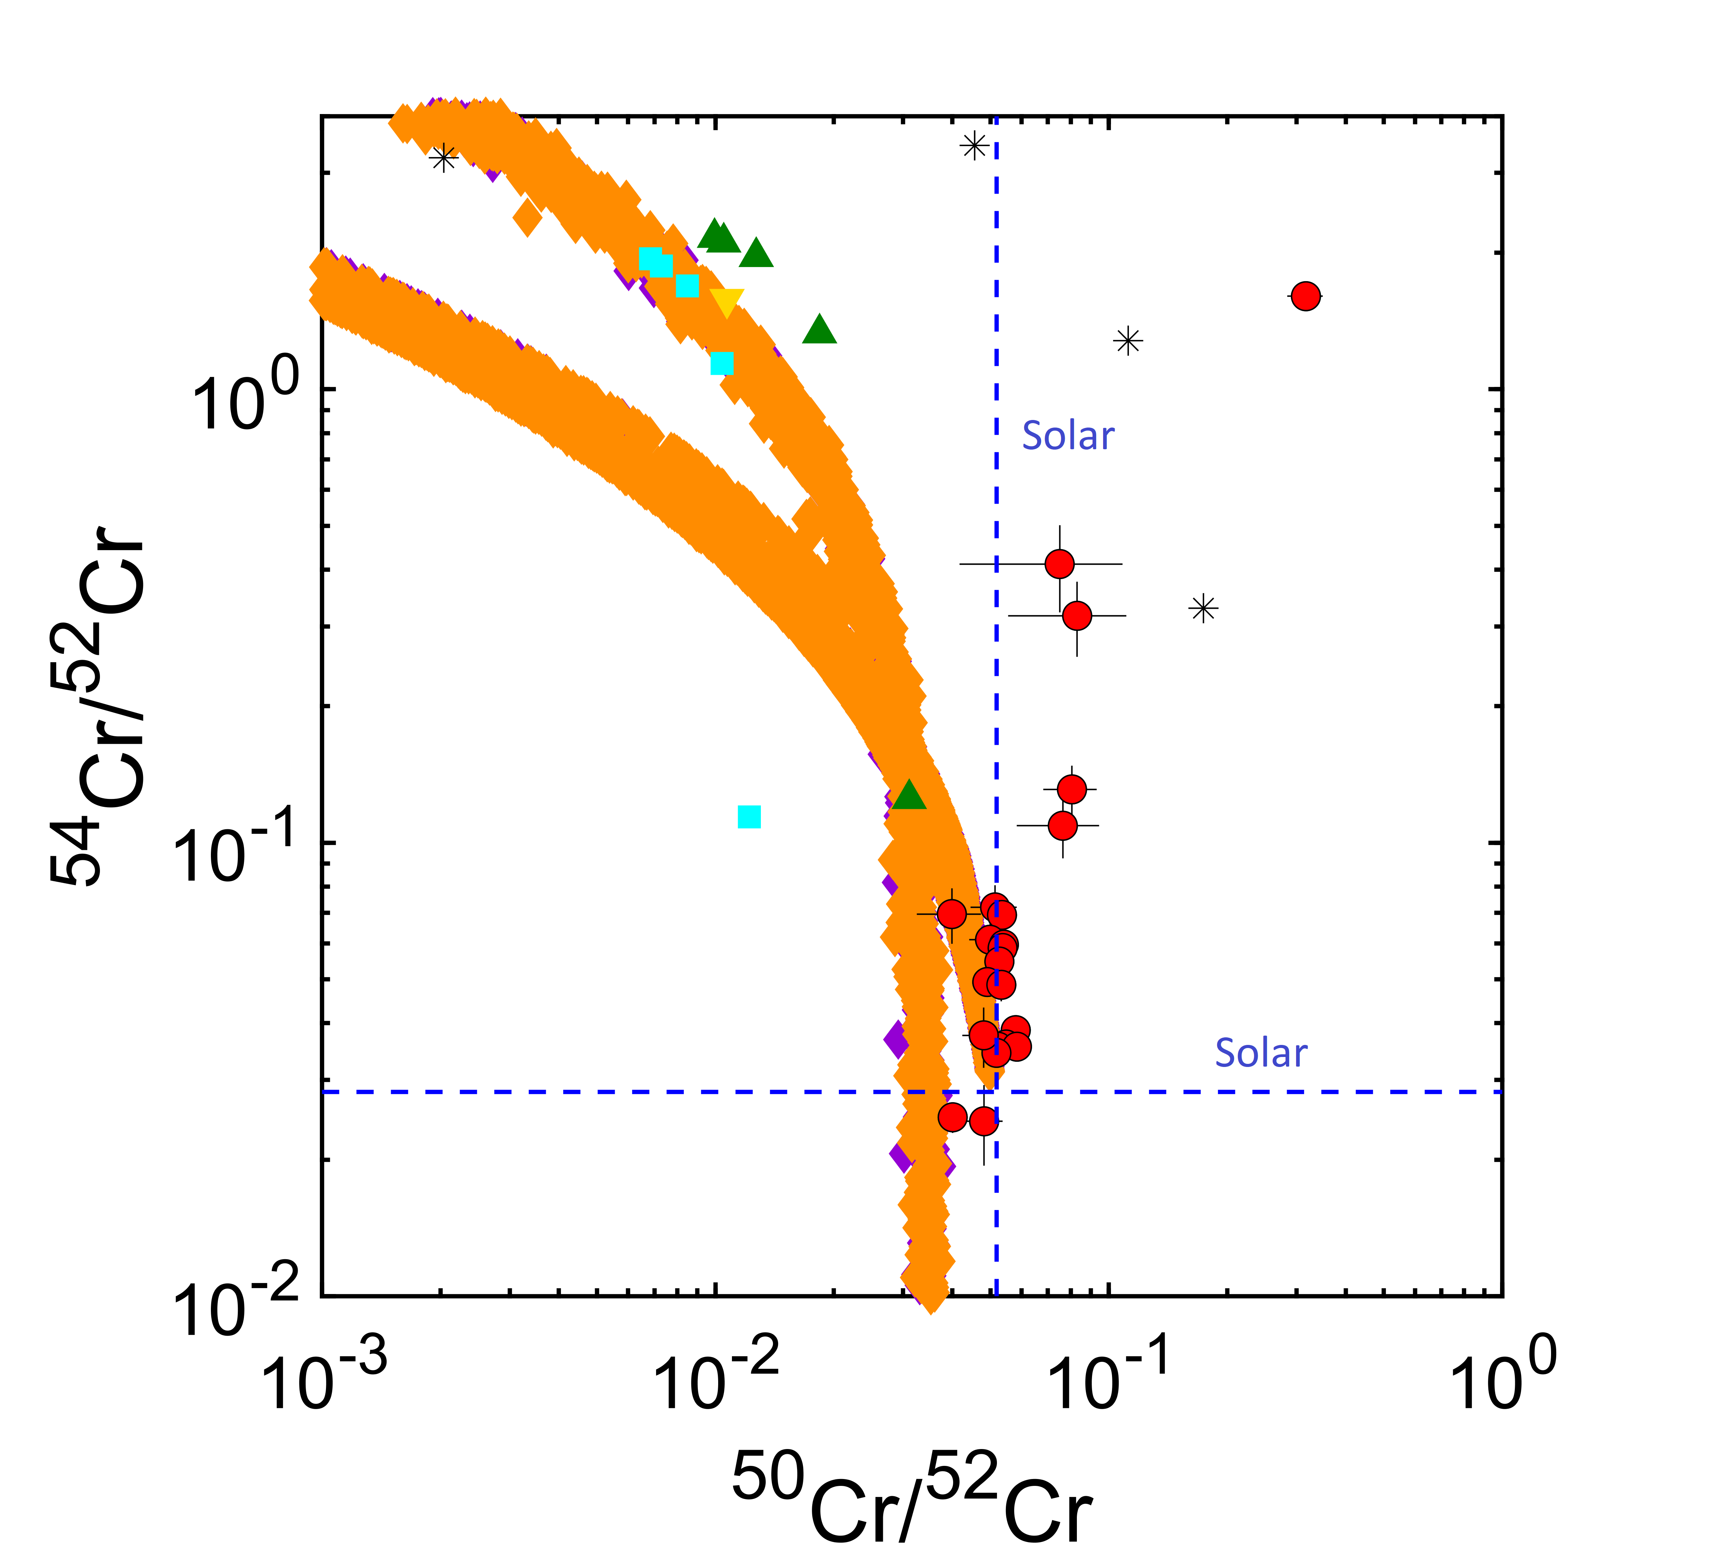
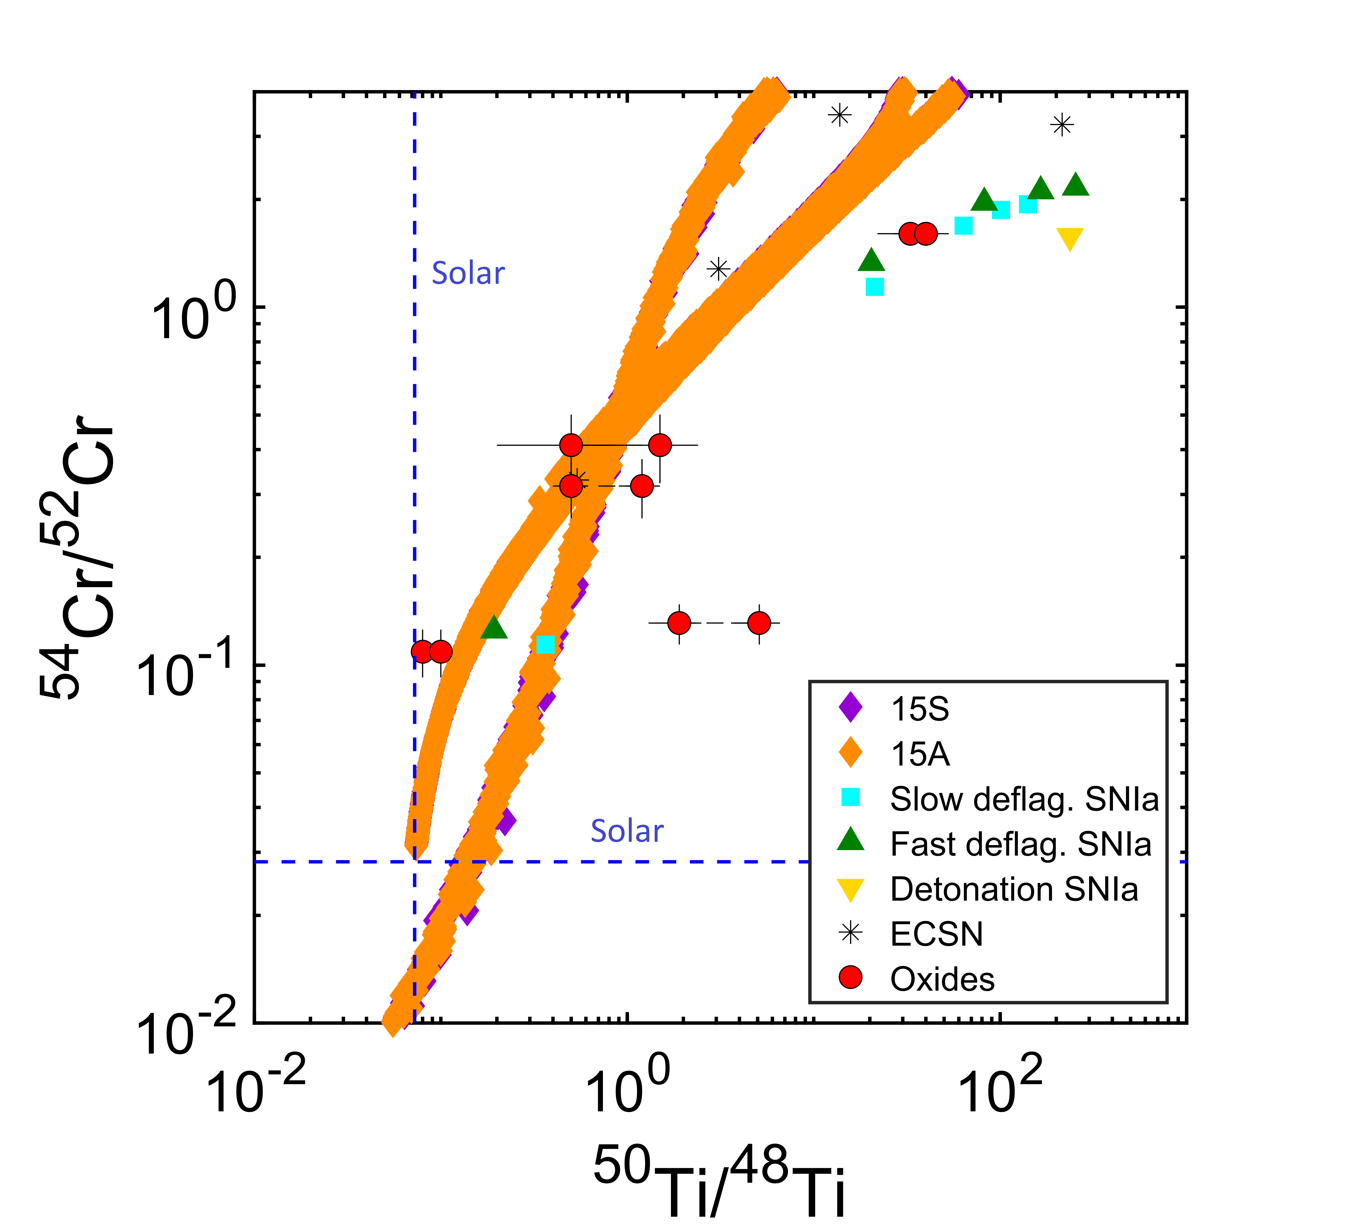
Comparison with stardust
Intro
Methods
Results
Conclusions

Slide 5
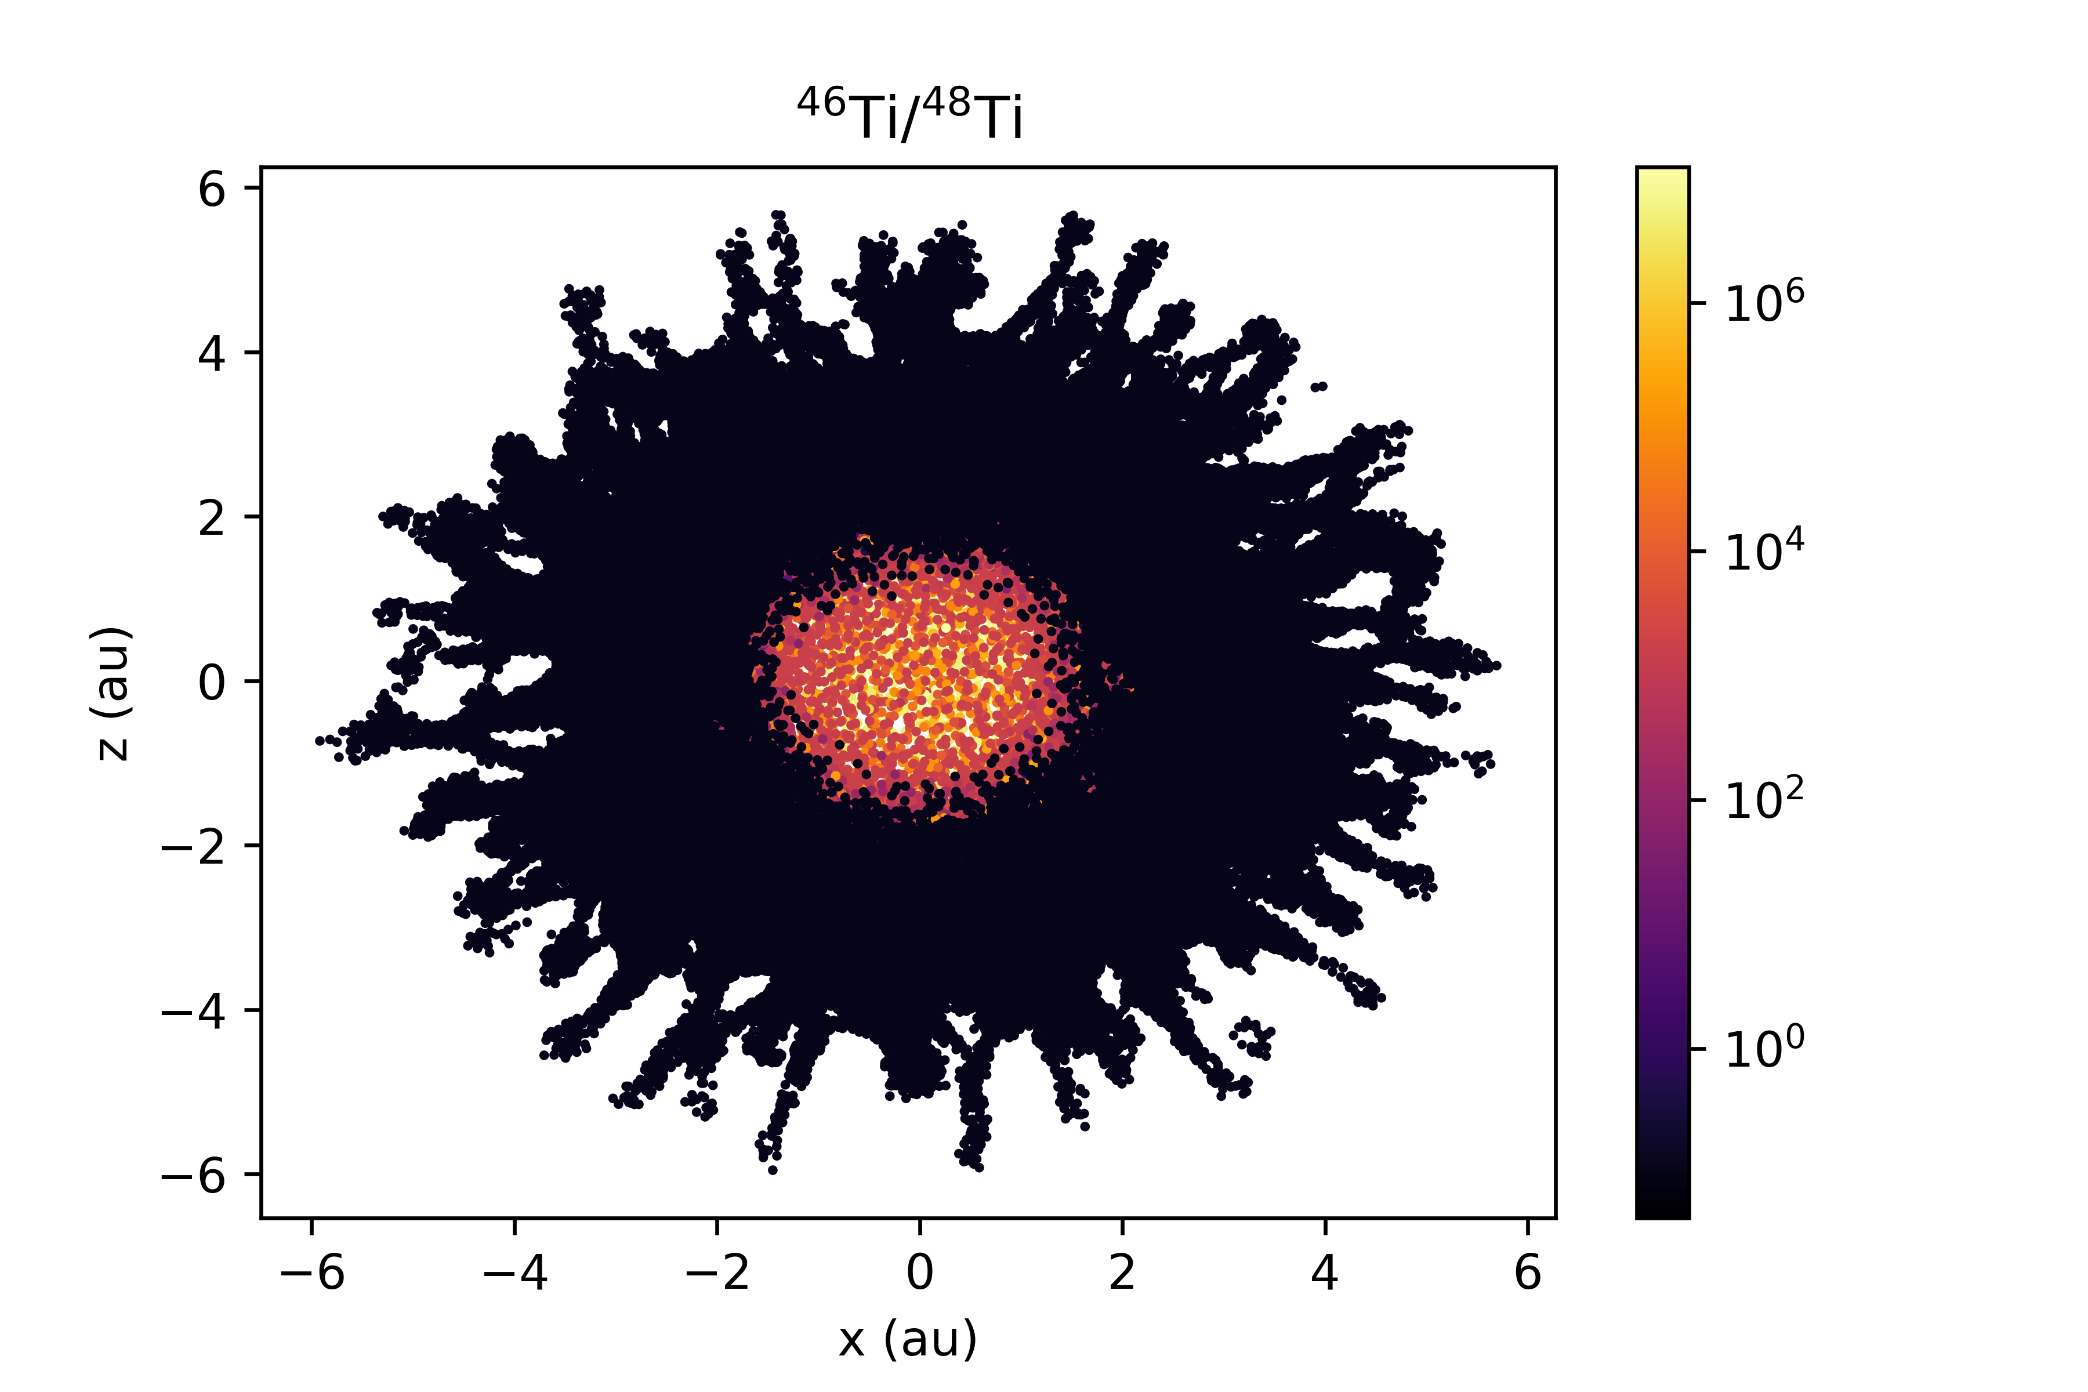
15S cross-sections (s-process)
Intro
Methods
Results
Conclusions

Slide 6
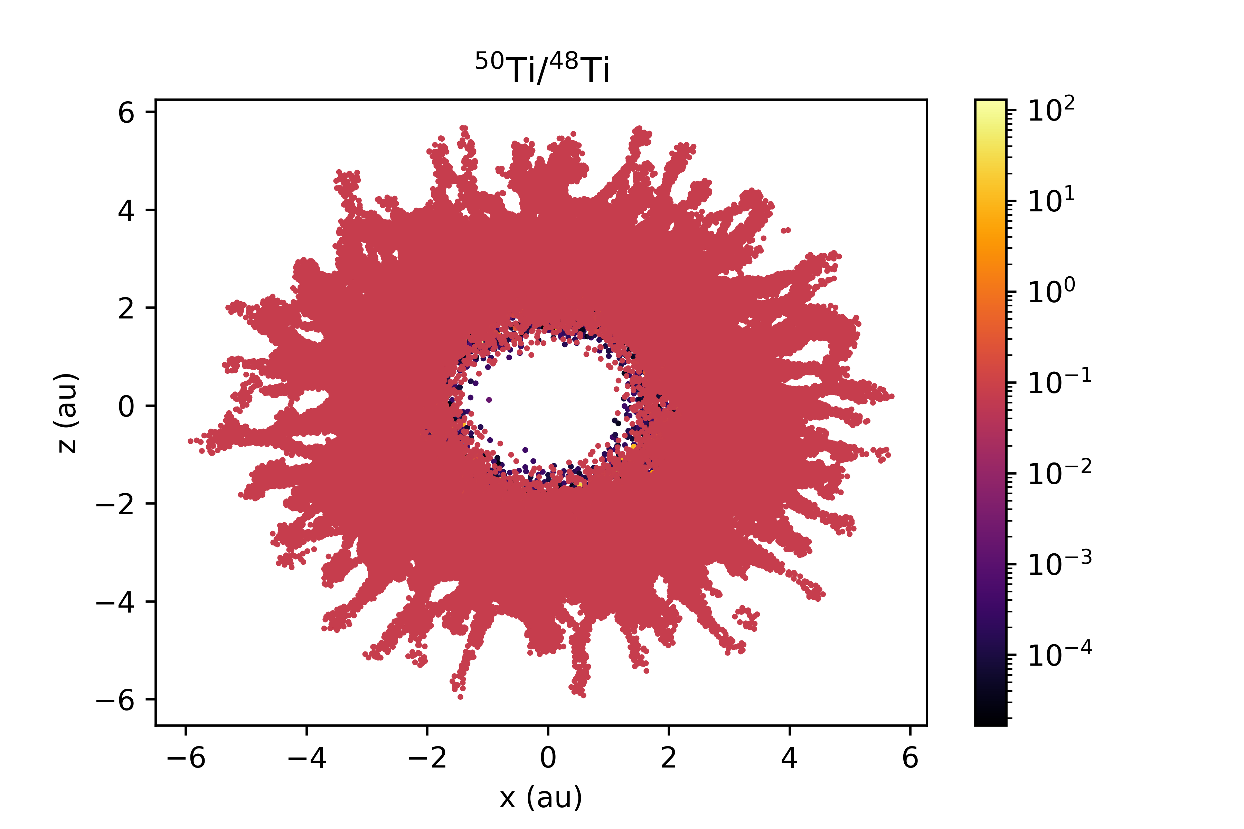
15S cross-sections (r-process)
Intro
Methods
Results
Conclusions

Slide 7
Conclusions
Intro
Methods
Results
Conclusions
Stardust with small enrichments of ⁵⁴Cr are best explained by CCSN, while those with large enrichments of ⁵⁴Cr and ⁵⁰Ti can be partially explained by ECSN
CCSN ejecta is heterogeneous in its s-process and r-process Cr and Ti compositions

Slide 8
Questions?
Intro
Methods
Results
Conclusions
Thanks for listening!
Acknowledgements
ASU/NASA Space Grant

